Slide 1
WEBATHON BY
Progate

Slide 2
Aim of a Webathon :
Progate offers an online program “week of learning”
in which we learnt about some basic needs of web
development like HTML ,CSS & JAVASCRIPT.
On the basis of some basic knowledge we have to
make an attracive web page for the aspiring developers
or coders those who are new in this field, so that they
can get start their practice in the field of web develop-
ment or as a coder. SO LETS GO THROUGH THE
FEATURES OF WEB PAGE…next slide is title.

Slide 3
BeACodeR made by : Varun Gera(AJAY KUMAR GARG ENG. COLLEGE)

Slide 4
Top section of a Web Page
Displayed on next slide:

Slide 5
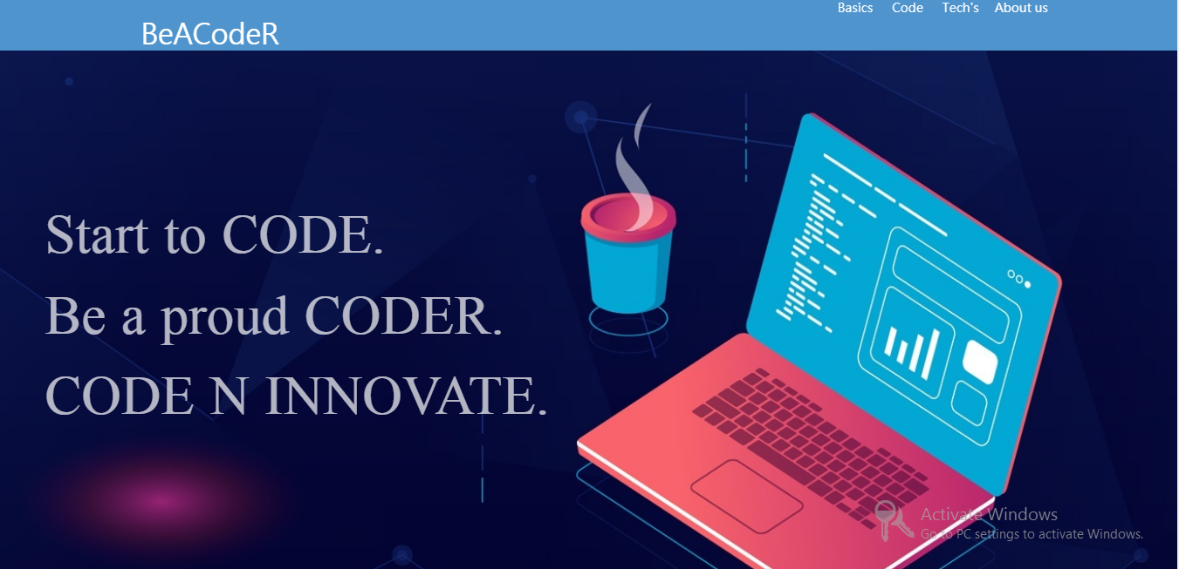

Slide 6
This section tells the basic steps for web-development.
Page displayed on next slide:

Slide 7
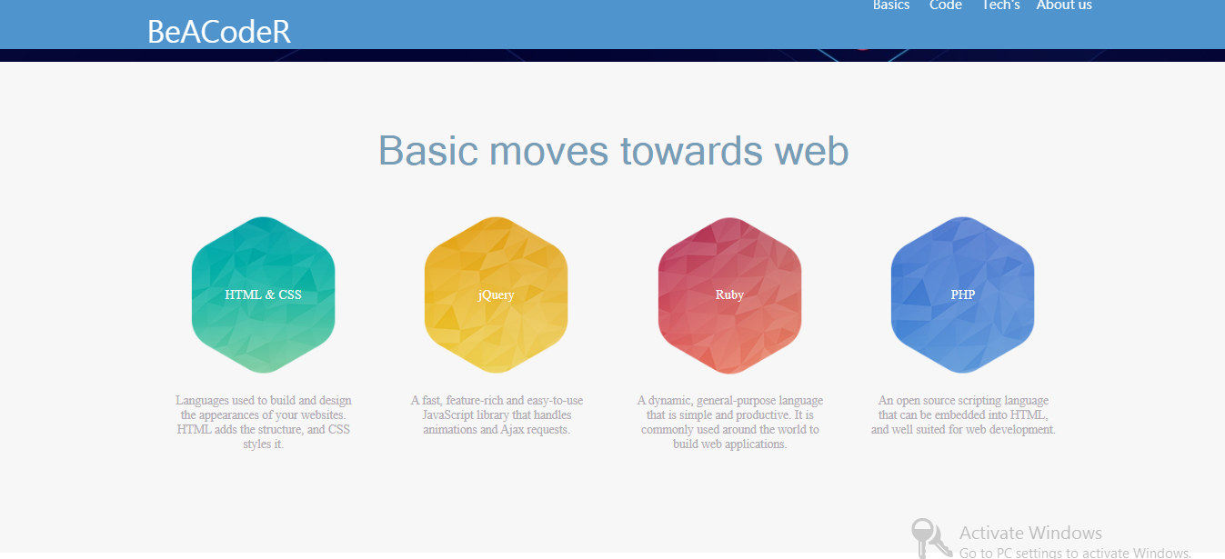

Slide 8
This section contains image to make page attractive:
Page is displayed on next slide:

Slide 9
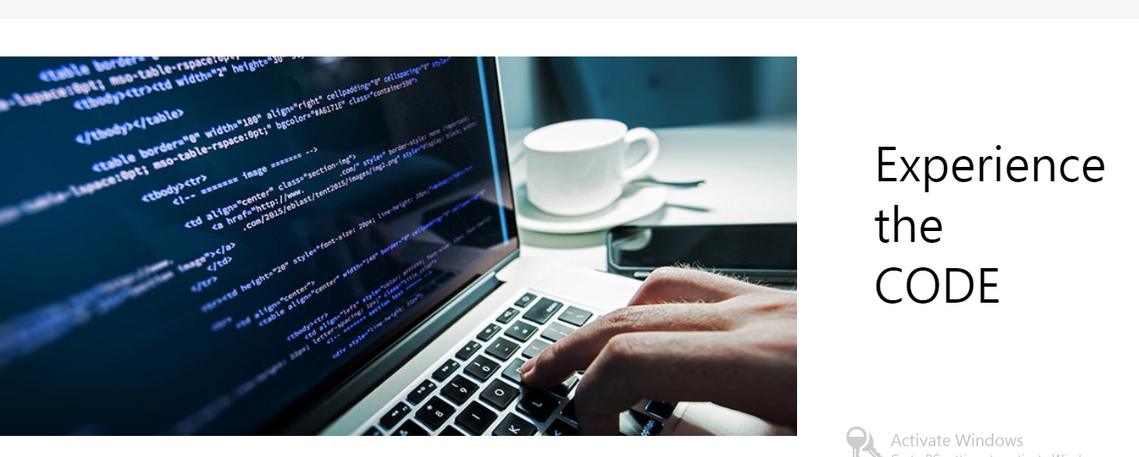

Slide 10
This section contain informaion about new tech’s.
Page displayed on next slide:

Slide 11
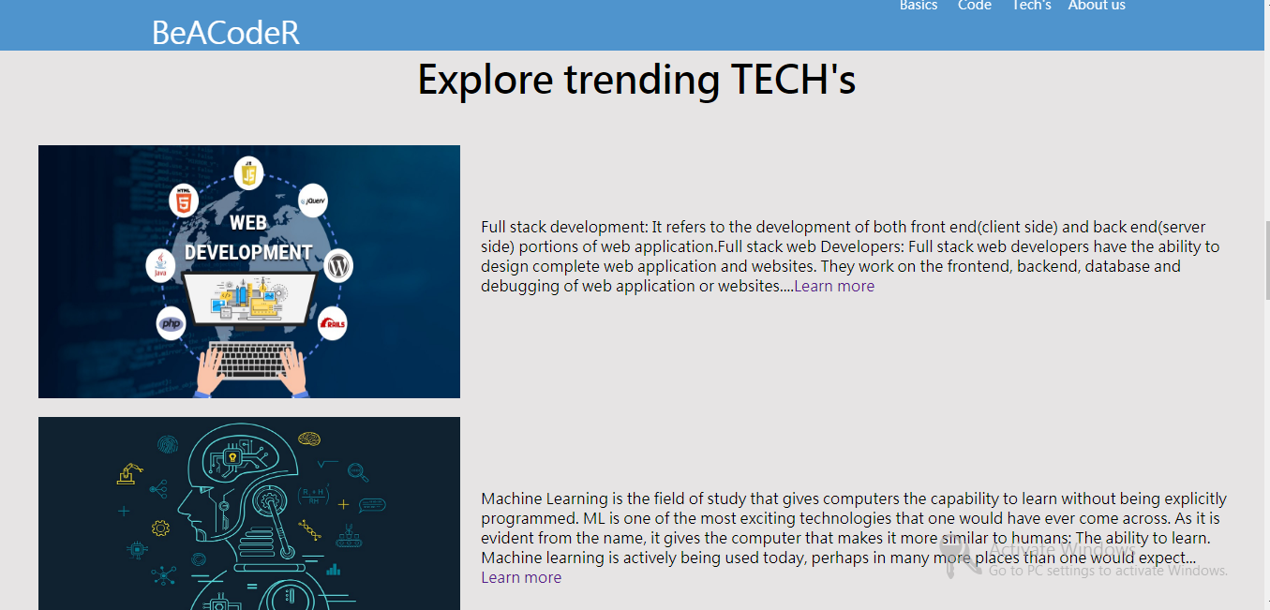

Slide 12
This section contains animated image to make page attractive
Page displayed on next slide:

Slide 13
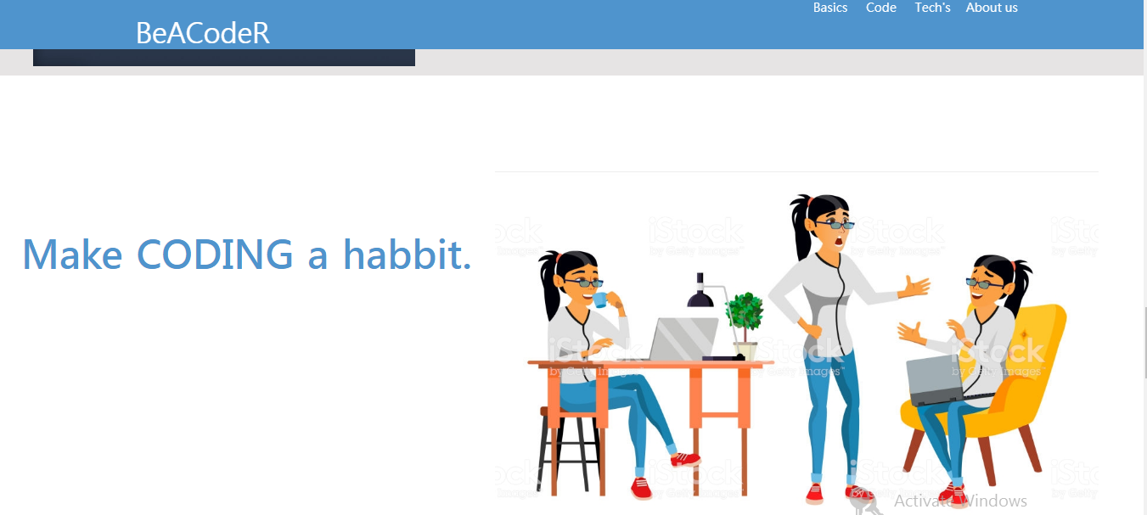

Slide 14
This section gives a link for various coding platforms.
Page displayed on next slide:

Slide 15
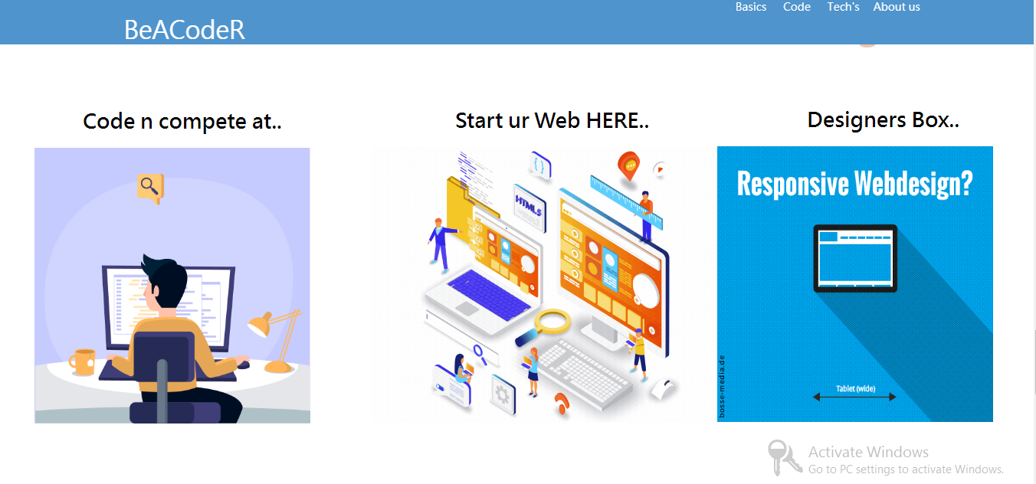

Slide 16
This section contains links to inspirational stories of various tech leaders.
Page displayed on next slide.

Slide 17
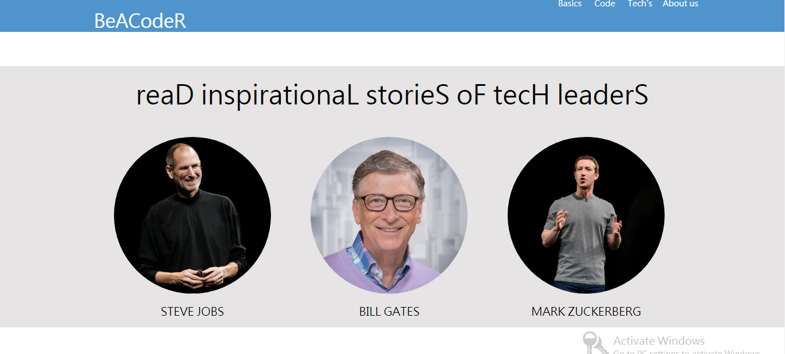

Slide 18
This is the ending section it contains various coding platform names.
Page displayed on next slide:

Slide 19
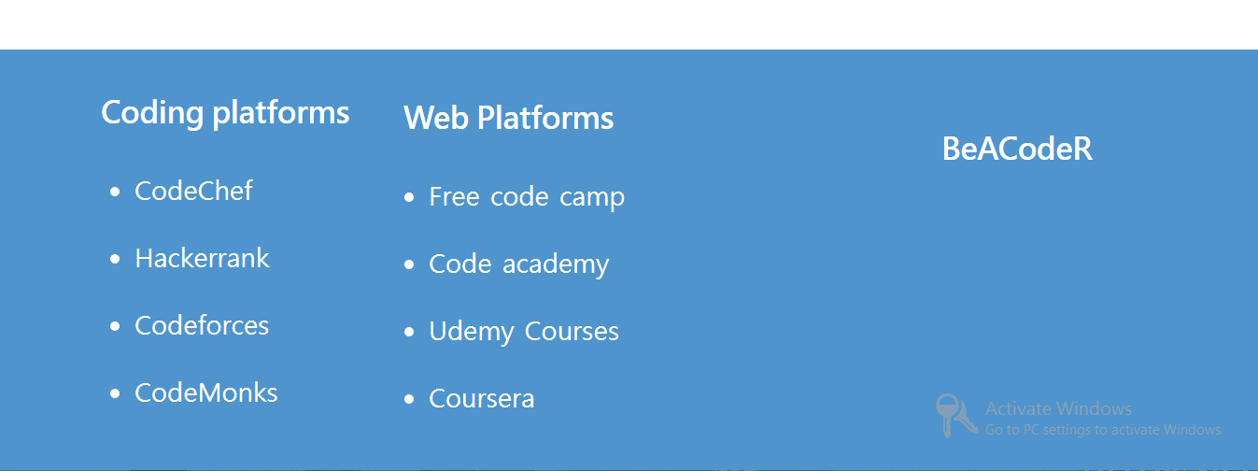

Slide 20
Thank you !

